Slide 1

Subject
NEURAL NETWORKS
SqueezeNet
TOPIC
Presented By:
1931009 – Laxminarayan Pimpdae
PGDM – BA,AI,ML 2019-2021

Slide 2
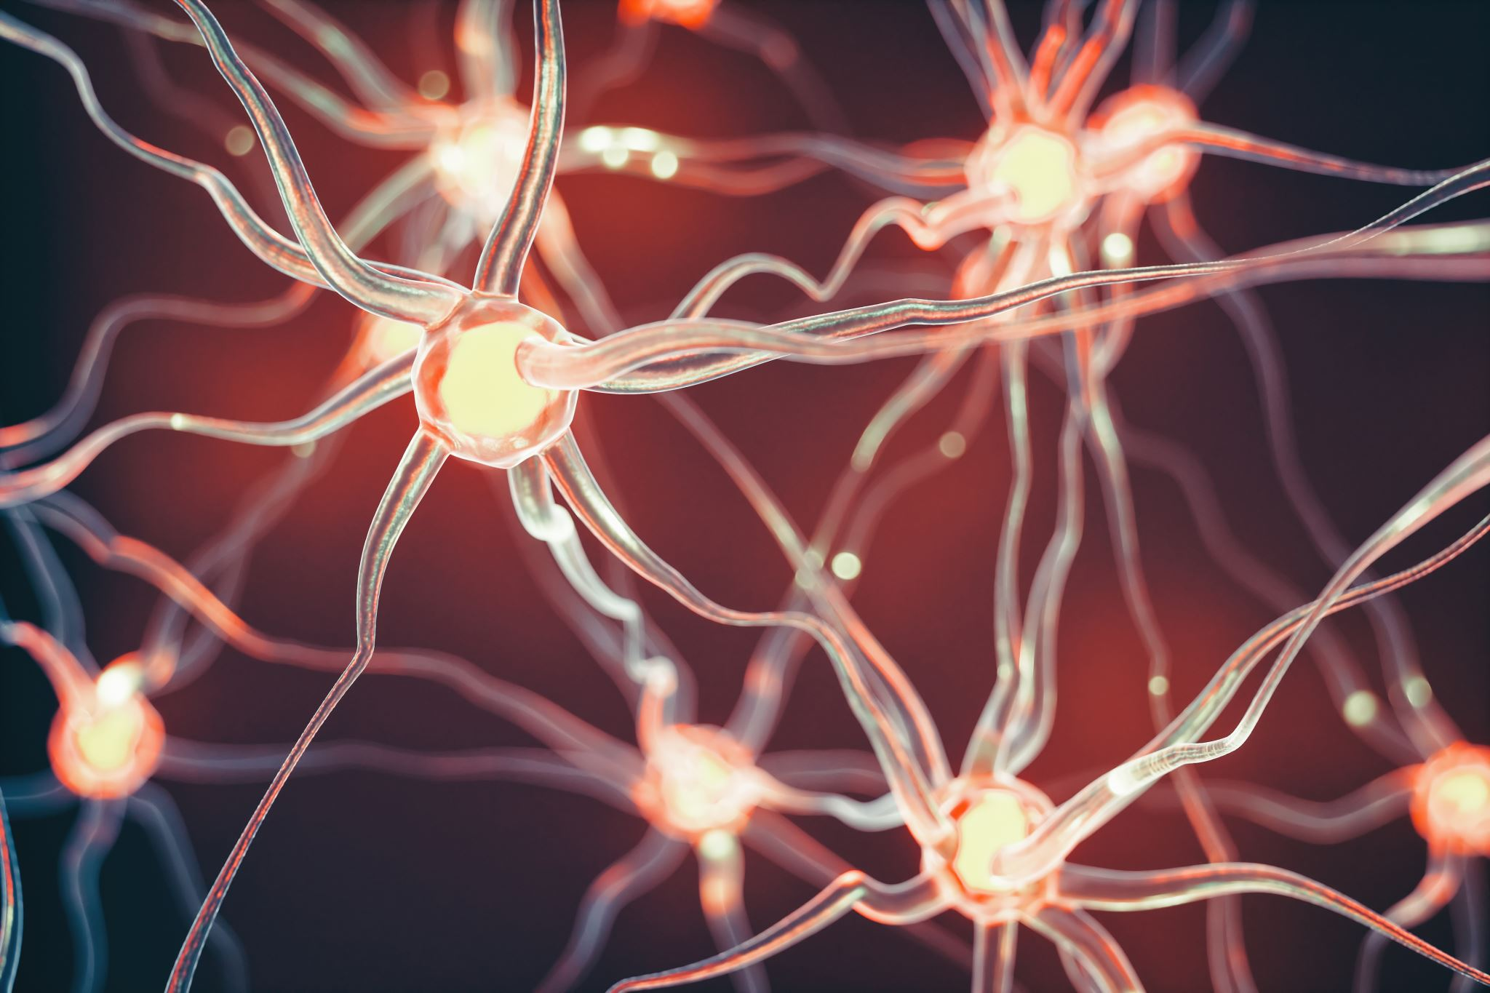
SqueezeNet
SqueezeNet is a smaller network that was designed as a more compact replacement for AlexNet.
It has almost 50x fewer parameters than AlexNet, yet it performs 3x faster.
This architecture was proposed by researchers at DeepScale, The University of California, Berkeley, and Stanford University in the year 2016.

Slide 3
SqueezeNet - Architecture
- This network’s architecture contains 3 main strategic ideas
Strategy 1:
Make the network smaller by replacing 3x3 filters with 1x1 filters
conventional 3x3 replaced by 1x1 convolution filters
1x1 filter has 9X fewer parameters than a 3x3 filter

Slide 4
SqueezeNet - Architecture
- This network’s architecture contains 3 main strategic ideas
Strategy 2:
Reduce the number of inputs for the remaining 3x3 filters.
fewer inputs to conv layers result in fewer parameters
achieved by using only 1x1 filters prior to the 3x3 conv layer called the squeeze layer
Strategy 3:
Down-sample late in the network so that convolution layers have large activation maps.
Make the most of smaller number of parameters and maximize accuracy.
Delaying down-sampling late in the network, creates larger activation/feature maps
Departure from more traditional architectures like the VGG network that use early down-sampling
Large activation maps results in a higher classification accuracy given the same number of parameters

Slide 5
SqueezeNet - Architecture
GENERAL STRATEGY :
Strategies 1 and 2 are about carefully decreasing the quantity of parameters in a CNN while attempting to preserve accuracy.
Strategy 3 is about maximizing accuracy on a limited budget of parameters.

Slide 6
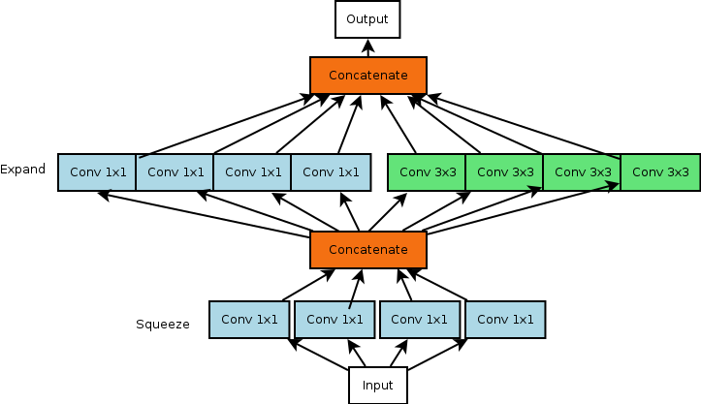
SqueezeNet - Architecture
FireModule
Building block used in the SqueezeNet
Employs strategies 1, 2, and 3.
Comprised of squeeze layers which have only 1x1 filters (strategy 1)
Comprised of expand layers which have a mix of 1x1 and 3x3 convolution filters
Number of filters in squeeze layer must be less than the expand layer (strategy 2)

Slide 7
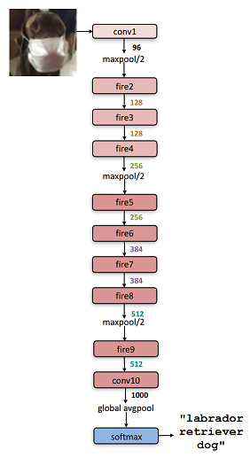
SqueezeNet - Architecture
Layers Breakdown
Layer 1: Regular convolution layer
Layer 2-9: Fire module (squeeze + expand layer)
Layer 10: Regular convolution layer
Layer 11: Softmax layer
FireModule
Architecture Specifications
Gradually increase number of filters per fire module
Max-pooling with stride of 2 after layer 1,4,8
Average-pooling after layer 10
Delayed down sampling with pooling layers

Slide 8
Thank You

